Slide 1
Aviation English
Axumawit Gebregorgis
Oleksandr Gorkovets
Ramona Graham

Slide 2
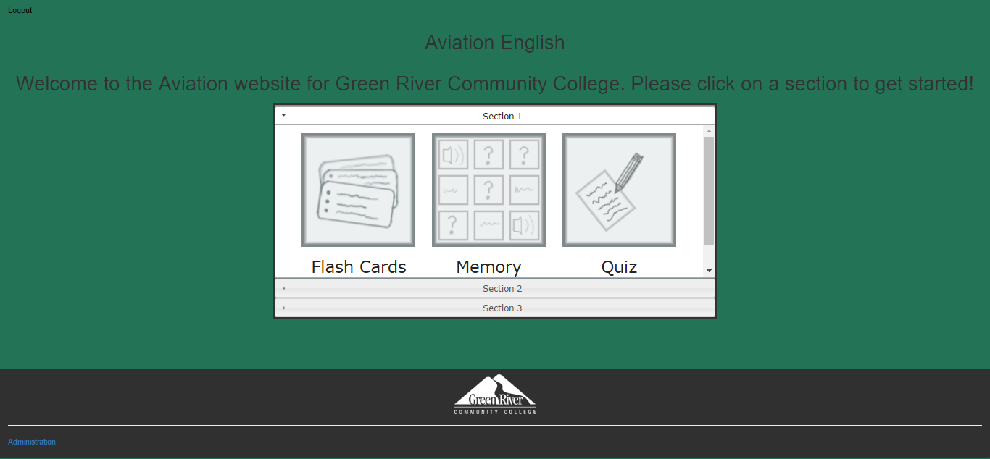
Main Page of the previous version

Slide 3
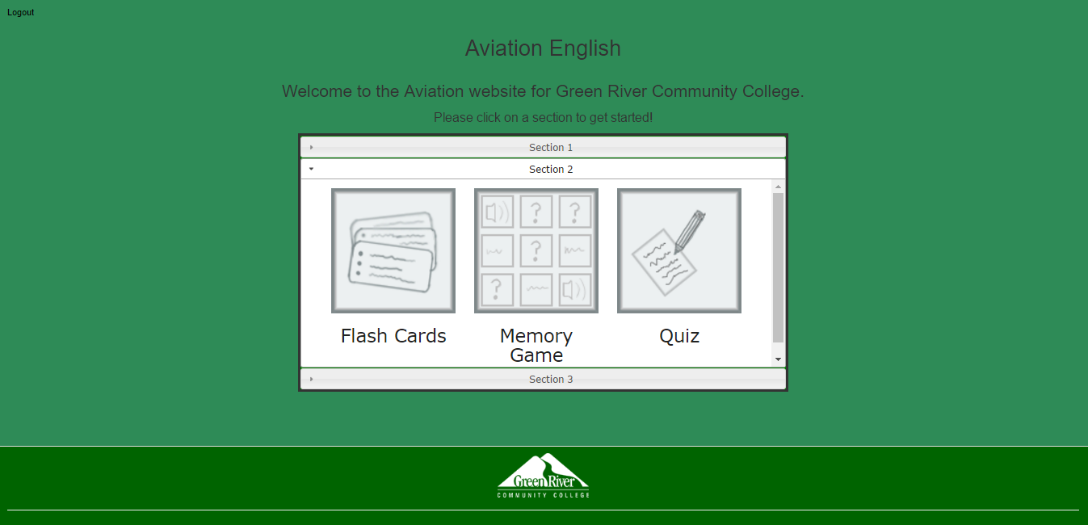
The new main page

Slide 4
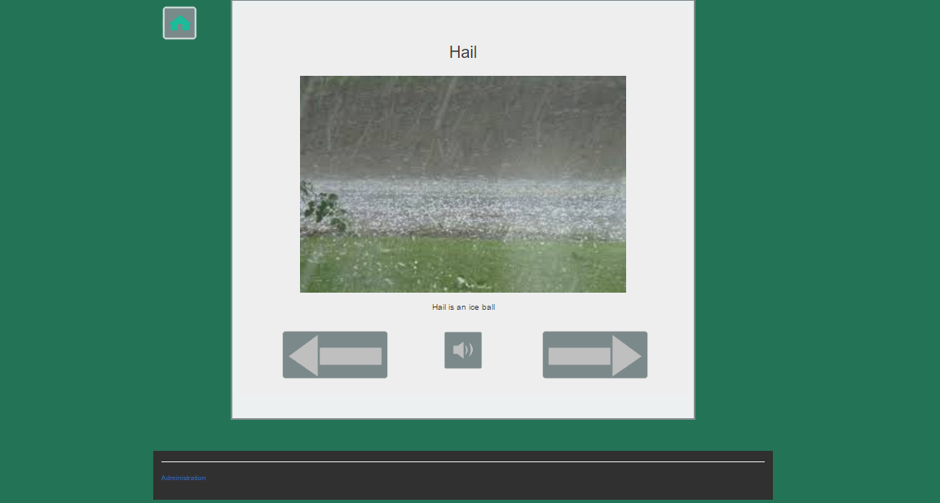
The Flash Cards page of the previous version

Slide 5
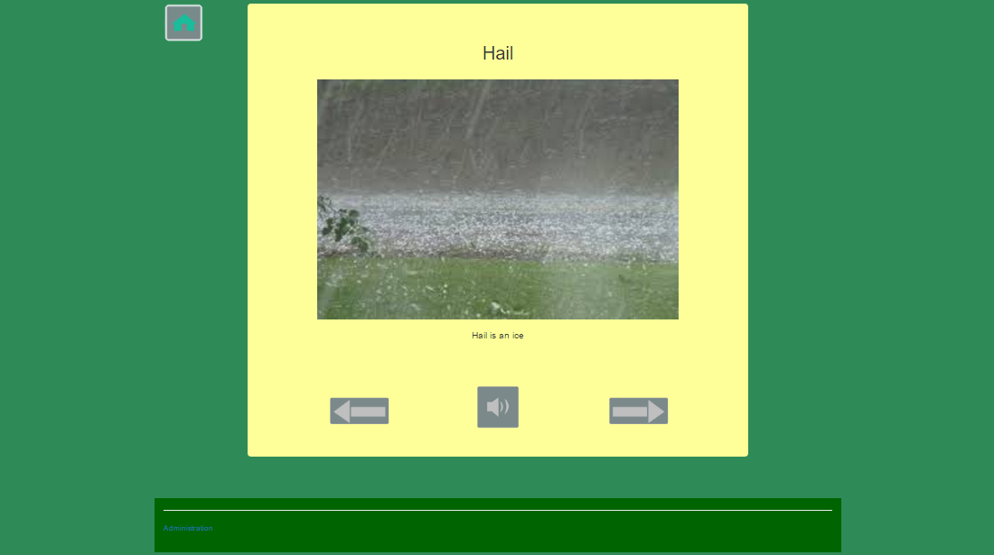
The new Flash Cards page

Slide 6
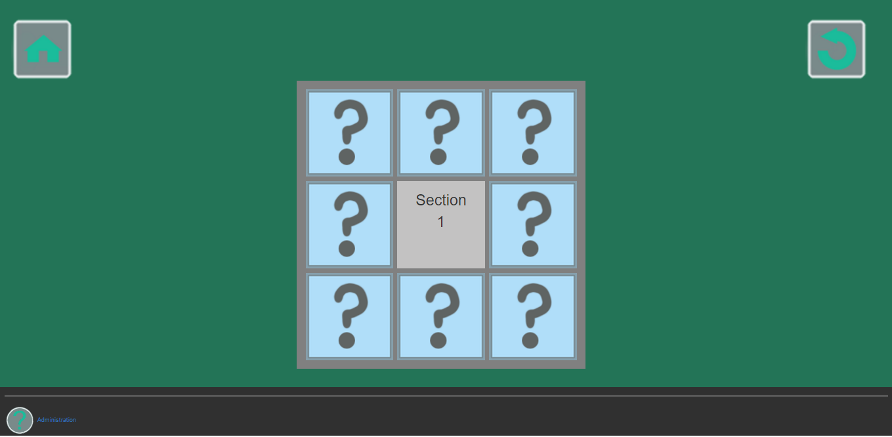
The previous Memory Game page

Slide 7
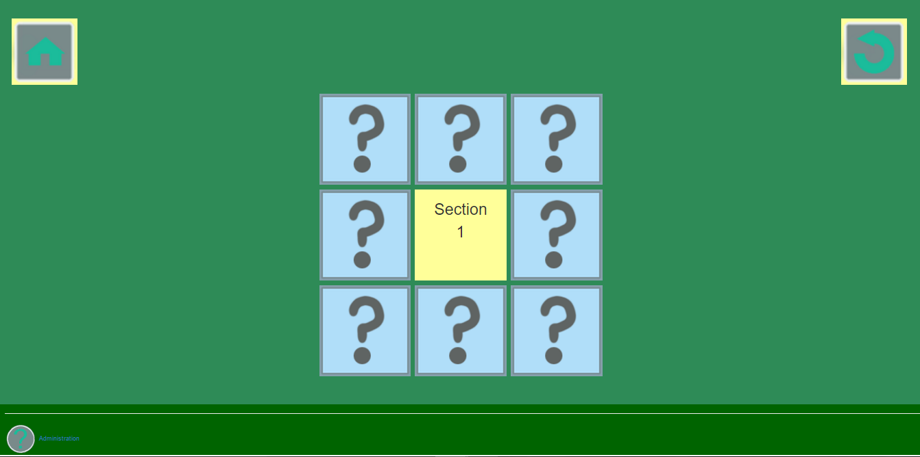
The new Memory Game page

Slide 8
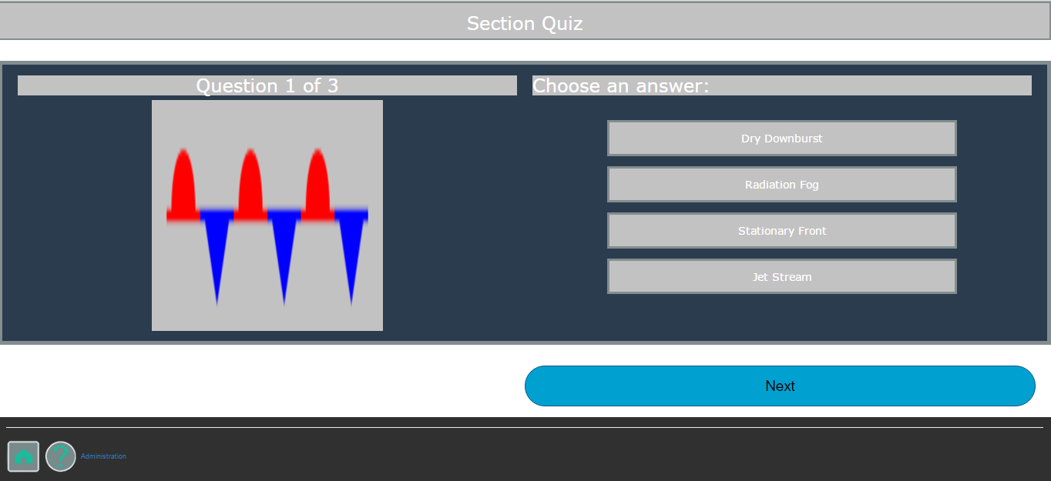
The previous Quiz page

Slide 9
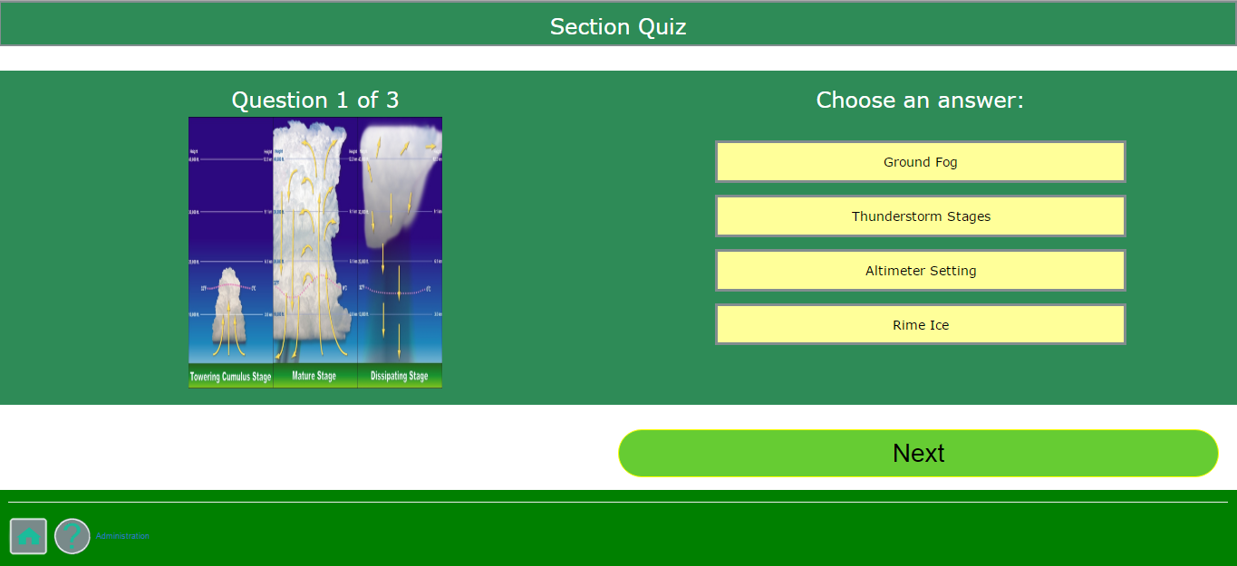
The new Quiz page

Slide 10
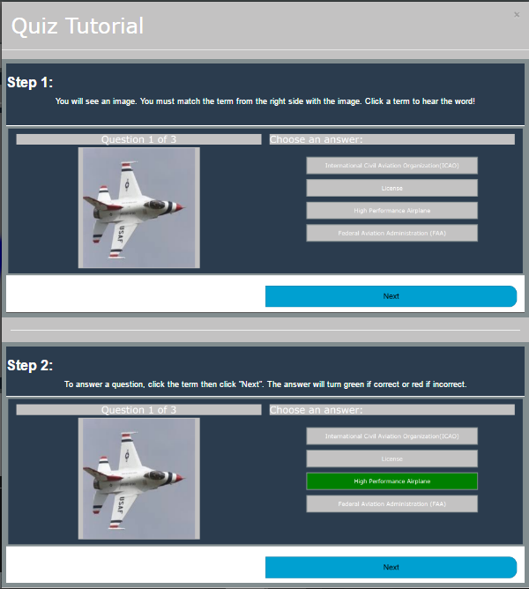
The previous Quiz Tutorial Page

Slide 11
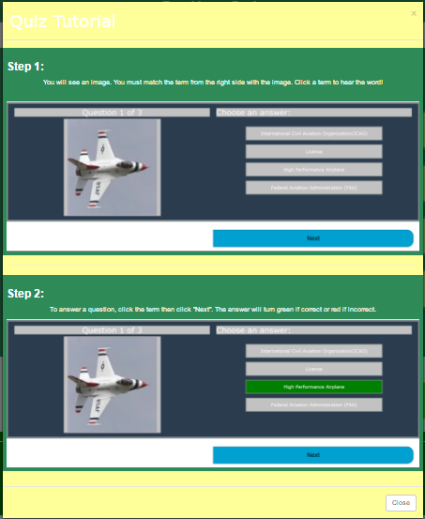
The new Quiz Tutorial page

Slide 12
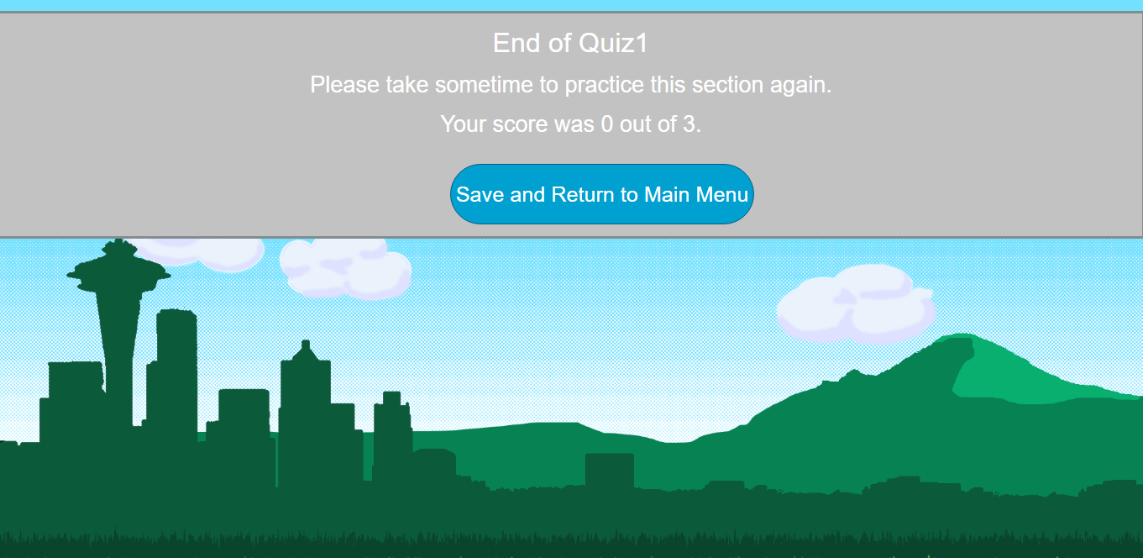
The previous End of Quiz page

Slide 13
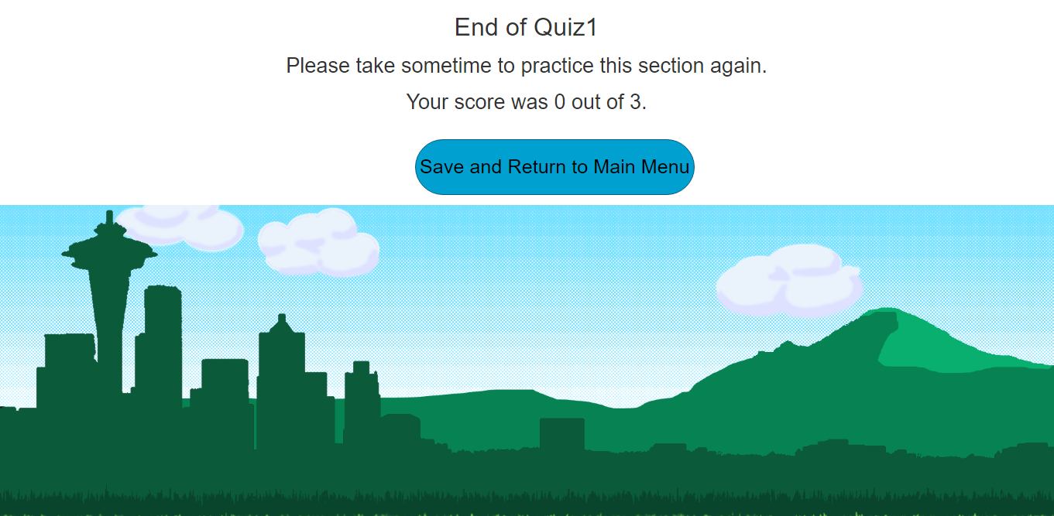
The new End of Quiz page

Slide 14
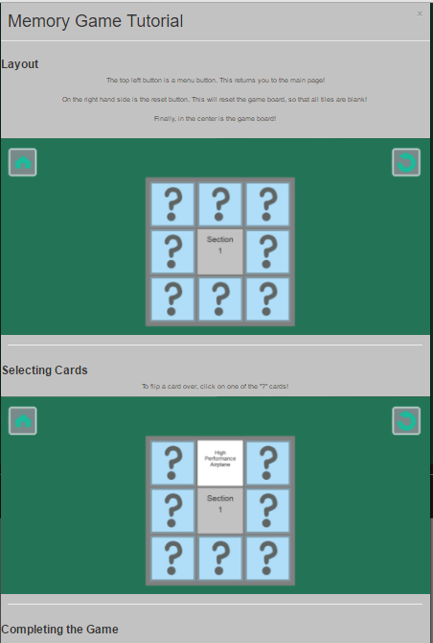
The previous Memory Game Tutorial page

Slide 15
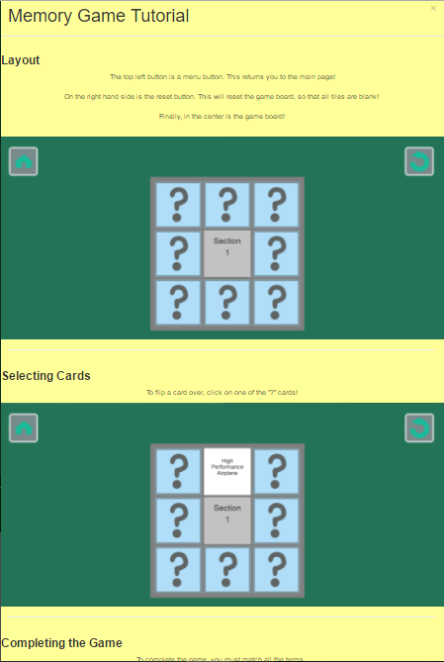
The new Memory Game Tutorial page

Slide 16
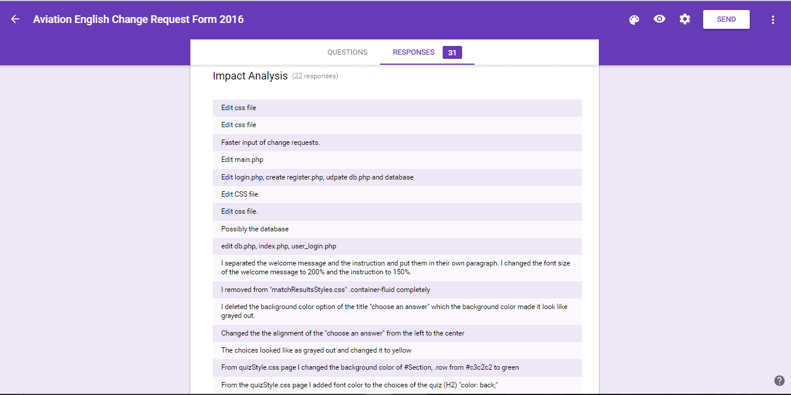

Slide 17



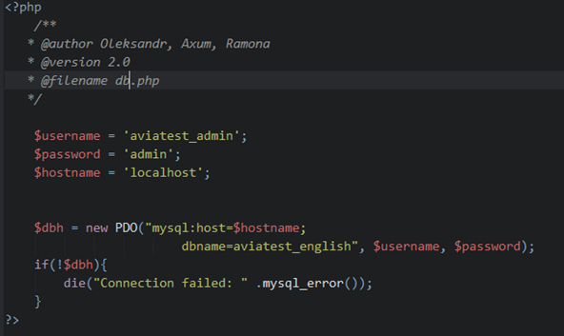


Code Reuse
db.php
main.php
main.php
main.php

Slide 18
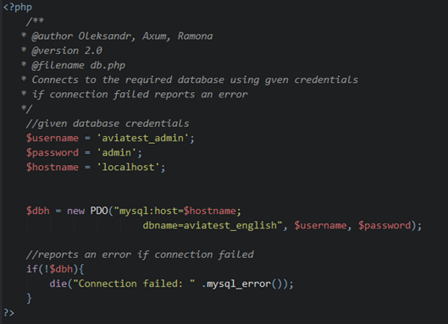
Comments
Use comments in the code to help to maintain the code

Slide 19
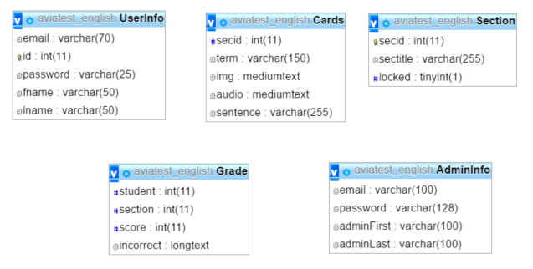
Database aviatest_english

Slide 20
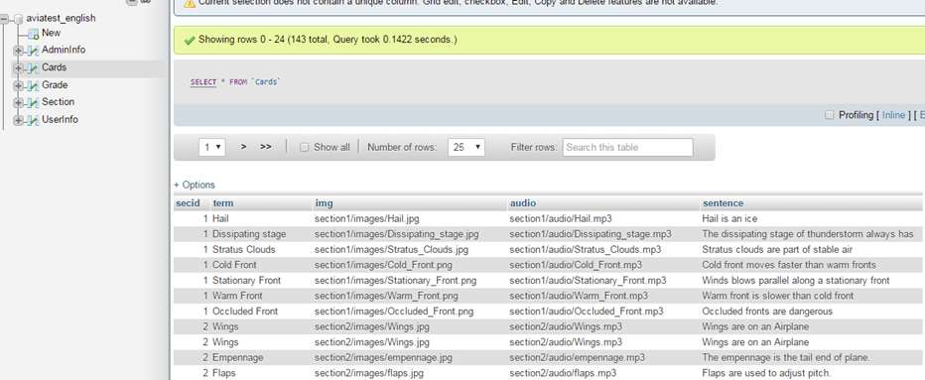
Database

Slide 21
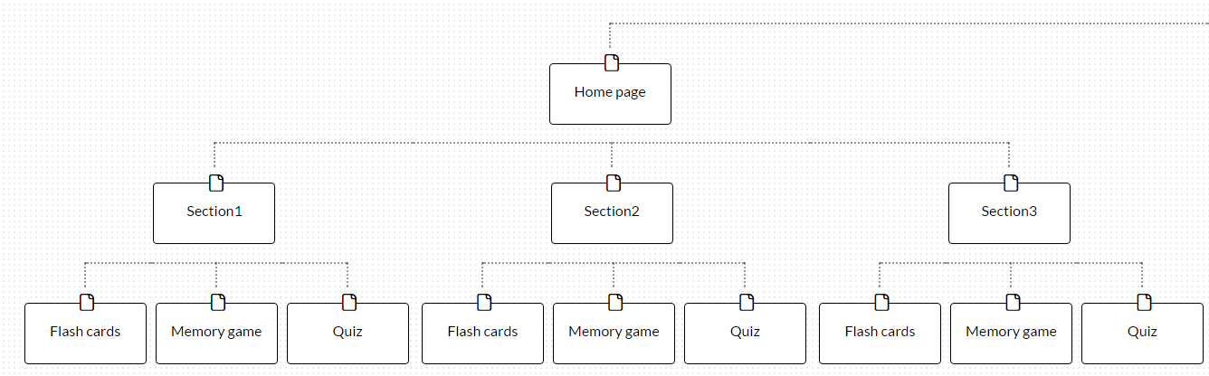
File Structure

Slide 22
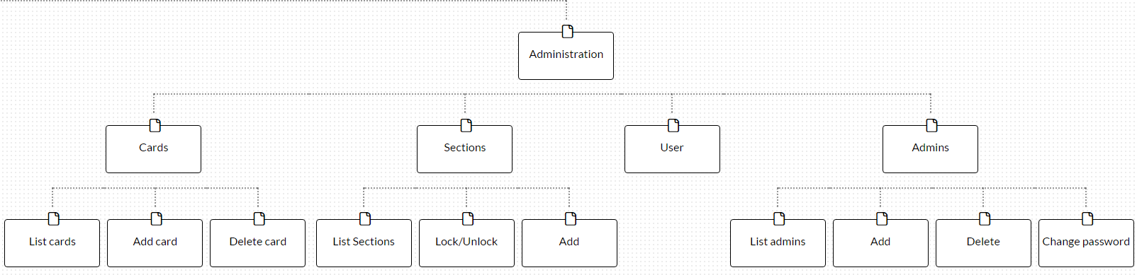

Slide 23
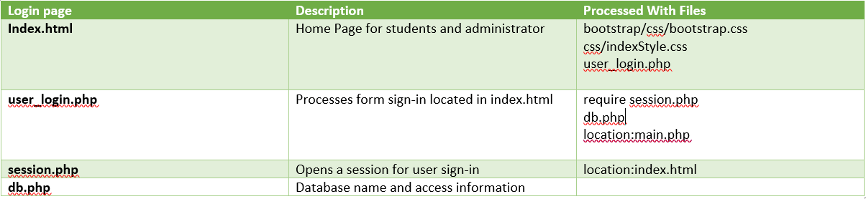
File structure cont.

Slide 24
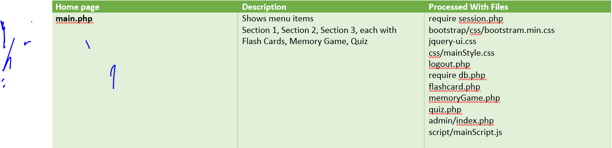
File structure cont.

